Slide 1
Project 6- Sales prediction
By Pradeep kumar chauhan

Slide 2
Introduction
In this Project, we analyze and document the feature engineering steps applied to the datasets provided in the notebook, specifically store.csv, train.csv, and test.csv to predict the sales.
We will perform no of different methods to predict the sales
We will select the best model suitable for the predictiono

Slide 3
Feature Extraction
Feature extraction is the process of transforming raw data into a set of measurable features (also called attributes or variables) that can be used to train a machine learning model. It is crucial for improving the performance of models, especially when the dataset is complex or unstructured (like text, images, or audio).

Slide 4
Prediction
Once you've extracted features, the next step is prediction, where a machine learning model is trained on the extracted features to predict outcomes on unseen data.
For example, after you extract features (from text, images, or structured data), you can use those features to predict a target variable like Sales.

Slide 5
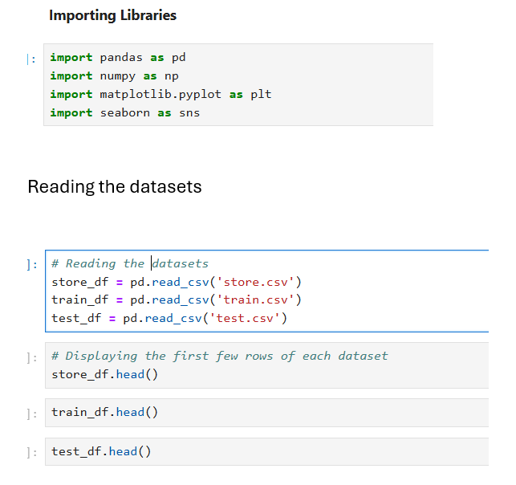
Importing libraries

Slide 6
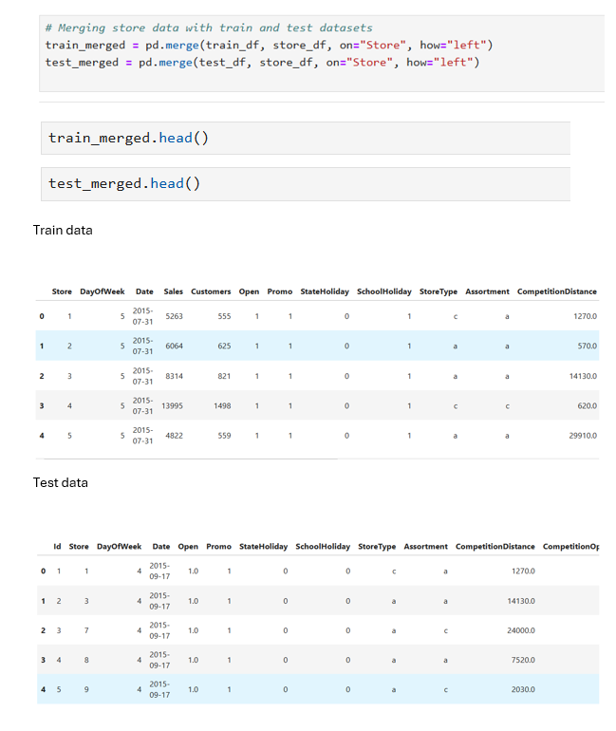
Merging store data with train and test datasets

Slide 7
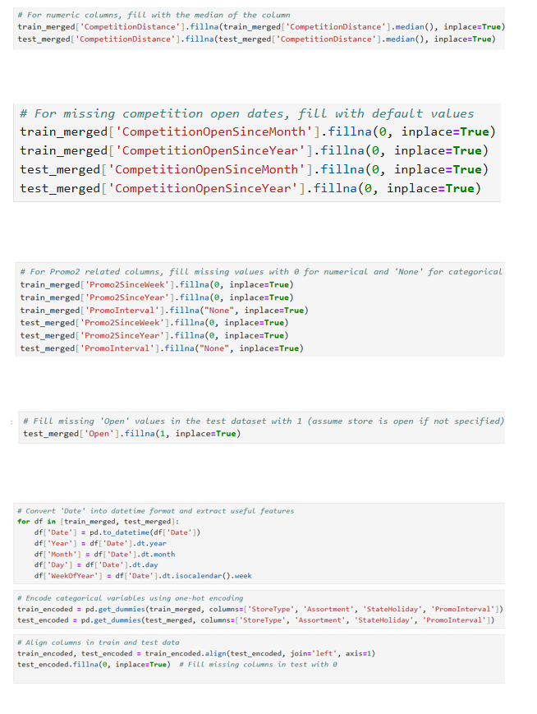
Handling missing values

Slide 8
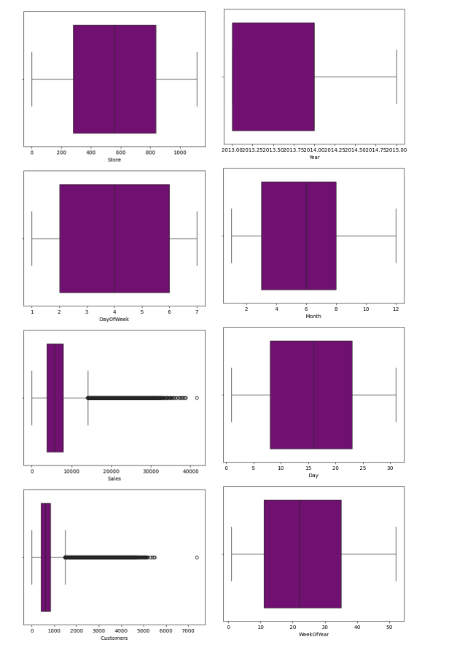
Checking the outliers

Slide 9
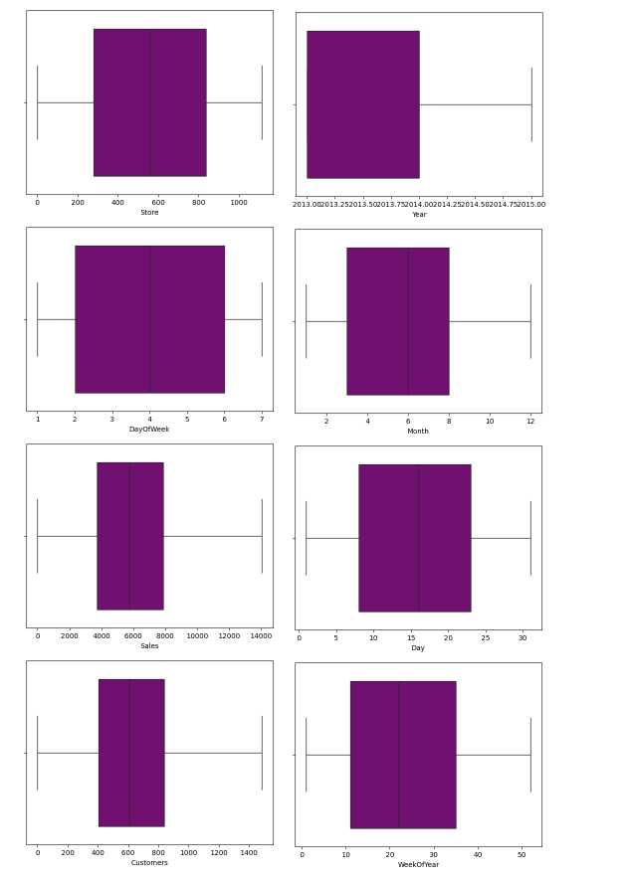
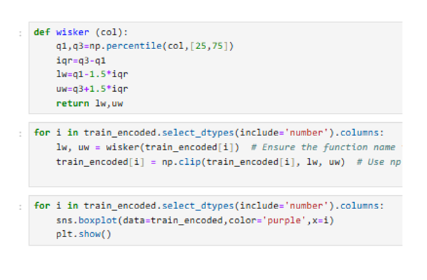
Treating the outliers

Slide 10
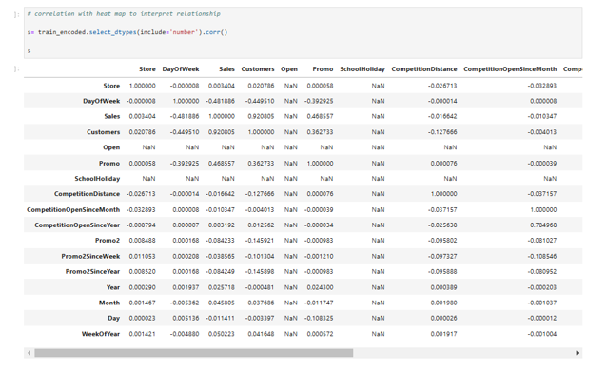
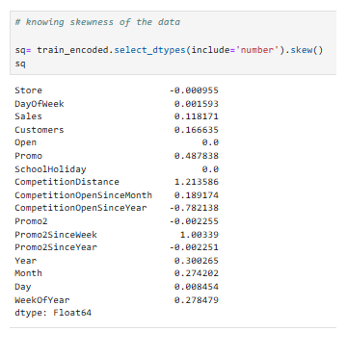
Correlation and Skewness

Slide 11
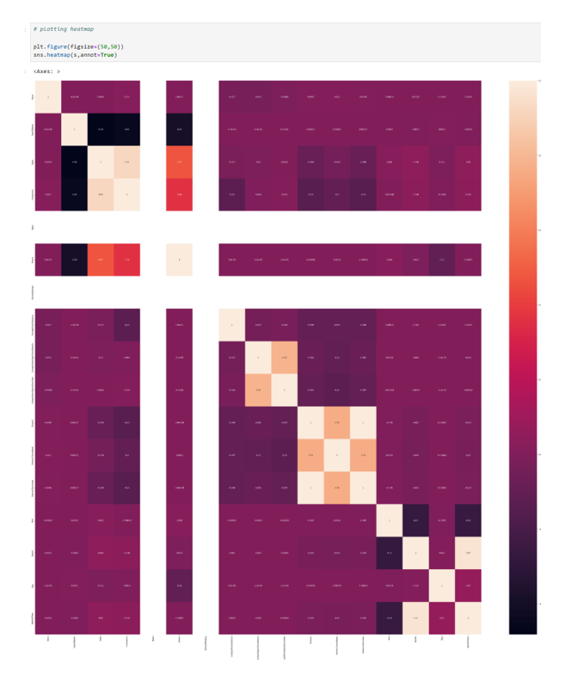
Heatmap

Slide 12
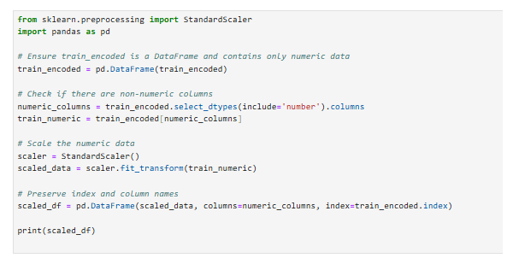
Standard scaling the data

Slide 13
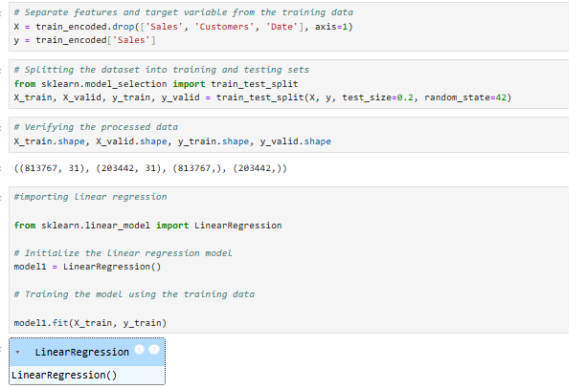
Linear Regression

Slide 14
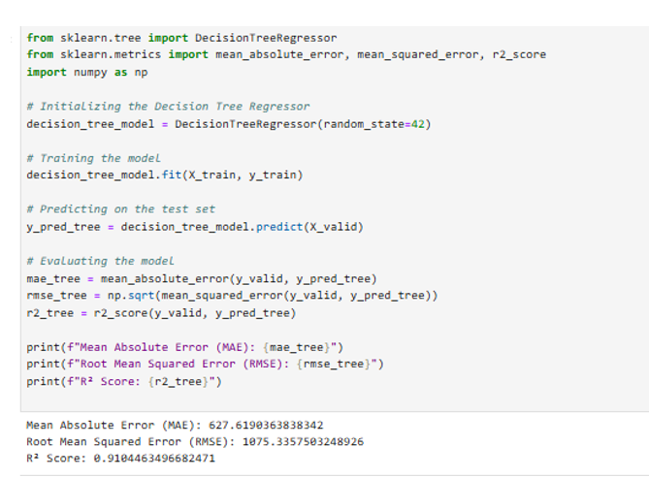
Decision Tree

Slide 15
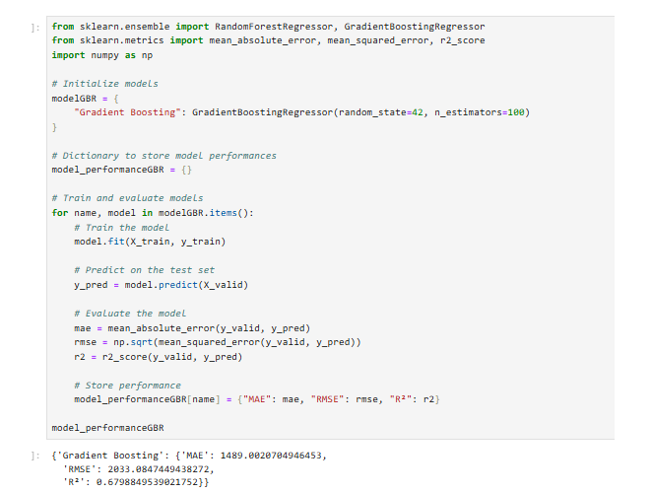
Gradient boosting

Slide 16
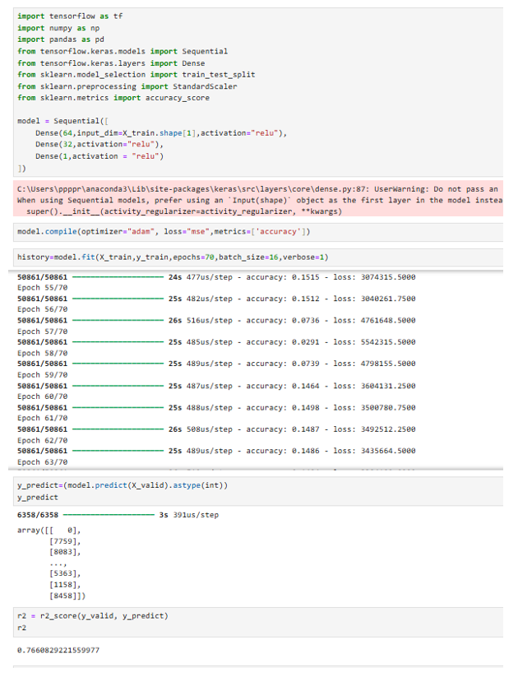
Deep learning model

Slide 17
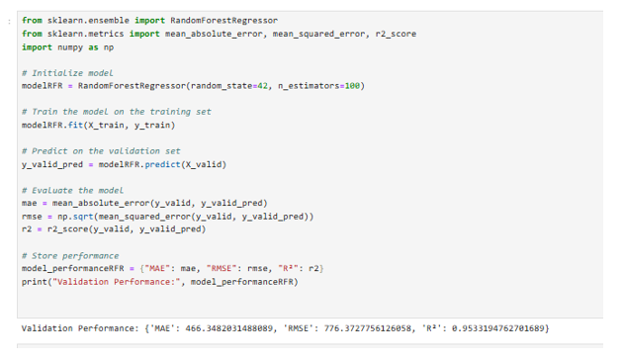
Radiant forest regression

Slide 18
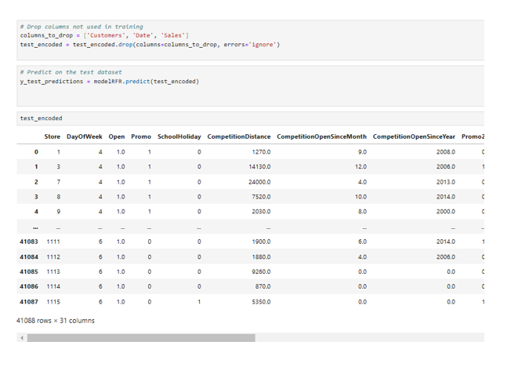
Predicting on test data set

Slide 19
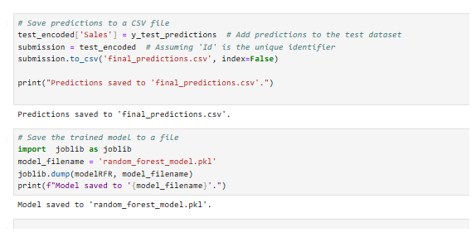
Saving prediction and the model

Slide 20
Thank you

